Slide 1
CSS Grid
Front-End Web Development

Slide 2
Lesson 05 Change Log FEWD 3.1–3.2
Below are the specific changes made in this lesson.
Returning Instructor Directions:
Click on the hyperlinks below, and it will direct you to the specific slide.
Copy the entire slide, and paste in your existing curriculum deck.
Pre-Class Materials and Preparation - Added one new CodePen — Flexbox in a Flexbox (More Detailed) - Starter Code — to Starter Code. Note that the solution code for the activity stays the same.
Share how the lesson went through our Instructor Lesson Exit Ticket - the Curriculum Feedback form: http://ga.co/curriculum-feedback

Slide 3
Pre-Class Materials and Preparation
Review all slides, lab activities, and code-alongs.
There are prompts in the speaker notes with opportunities for instructor customization.
Materials:
Reference Code
Starter Code in CodePen
Solution Code in CodePen

Slide 4
CSS Grid
Overview
This lesson introduces CSS Grid properties to expand upon the layout abilities gained from flexbox.
Learning Objectives
In this lesson, students will:
Create responsive layouts using CSS Grid properties.
Compare and contrast flexbox and Grid properties.
Define fractional and percentage-based widths for elements.
Duration: 180 minutes

Slide 5
Suggested Agenda
Time | Activity | Purpose
0:00–0:30 | Nested Flexbox/Flexbox Review | Review Flexbox properties and show the complexities/limitations of flexing on two dimensions.
0:30–1:00 | CSS Grid | Learn properties needed to execute CSS Grid.
1:00–1:30 | Grid Walkthrough/Recreate Grid Properties With Flex | Show how flex and Grid are inter-connected tools used for similar purposes.
1:30–2:00 | Implicit Tracks/Grid Gap | Learn more tools for dealing with large collections in Grid.
2:00–2:30 | Making a Grid With Images | Applying new Grid rules with a collection of images.

Slide 6

Today’s Learning Objectives
In this lesson, you will:
Create responsive layouts using CSS Grid properties.
Compare and contrast flexbox and Grid properties.
Define fractional and percentage-based widths for elements.
‹#› | © 2020 General Assembly
Notes:
DURATION: 1 minute
TEACHING TIPS:
Learning objectives help frame the lesson and give students an idea of what to expect and focus on.
Explain to students how this lesson fits into the overall course to help them make connections with content from other lessons.

Slide 7
Warm-Up: The Bad Intern
Front-End Web Development

Slide 8
The Bad Intern
Your client has had an intern work on a content page and something has gone horribly wrong. They are now in a panic and have asked you to try to repair the damaged page.
Starter code:
https://drive.google.com/drive/folders/1iu8NuEt_y9v2z3Ap_SABqPOErz5iuY6A?usp=sharing
Solution code:
https://drive.google.com/drive/folders/1iu8NuEt_y9v2z3Ap_SABqPOErz5iuY6A?usp=sharing
Notes:
TEACHING TIPS:
Work through this example with the class (this should be a 20–30-minute exercise).
Solution: https://codepen.io/GAmarketing/pen/YzzJRRM

Slide 9
Flexbox Questions
Think!
In which direction does a flexbox natively go: horizontal or vertical?
What CSS property adjusts that?
How do you reorder flexbox children?
What CSS property adjusts that?
Can you nest a flexbox inside of a flexbox?
Why would we want to do that? Doesn’t flexbox fix everything?
Notes:
TEACHING TIPS:
If teaching remotely, use a Slack thread for each separate question. This should be a refresh on the specifics, as well as a reminder that knowing what CSS can do is more important than memorizing the details of how to do it (which can be picked back up easily through searching).

Slide 10
Nested Flexboxes
Together, let’s build a series of four sections aligned within a flex container, with each individual section also being a flex container! Remember, flex properties only affect direct children, often requiring flex children to be flex parents as well!
Starter code:
https://codepen.io/GAmarketing/pen/LYYgXgX
Solution code:
https://codepen.io/GAmarketing/pen/YzzJRRM
Notes:
TEACHING TIPS:
Work through this example with the class (this should be a 20–30-minute exercise).
Solution: https://codepen.io/GAmarketing/pen/YzzJRRM

Slide 11
CSS Grid
Front-End Web Development

Slide 12
What Is a Grid?
Picture spreadsheets: Columns and rows into which you can lay content.
Grids ensure that elements will line up smoothly across the page.
Notes:
TALKING POINTS:
After years of struggling with floats, clears, position, and margin tricks, most developers would give anything to just be able to set up a grid and say: “Each of these takes up a third of a page.” Now we can, but it took a long time to get here!

Slide 13
Comparing Three Tools for Layouts
Floats
Flexbox
Grid
Floats help flow text around an image; they aren’t great for layouts.
Interrupt regular document flow.
Flexbox only works in ONE dimension at a time, with a main axis and a cross axis.
However, you can nest flex containers.
Grid works in two dimensions all of the time, defining rows and columns.
A clearer declaration of complicated patterns.
Notes:
TEACHING TIPS:
Reinforce the idea that there are multiple ways of achieving the same goal, and knowing the best use case for a given technique is just as important as knowing the technique itself. Grid isn’t always the best answer, and neither is flexbox! Discuss the pros and cons of each of the three tools.
In order to convey that both Grid and flexbox complement each other but that one is used for layout (Grid) and the other for content (flexbox) review, this article with the class: https://medium.com/youstart-labs/beginners-guide-to-choose-between-css-grid-and-flexbox-783005dd2412

Slide 14
Flexbox Can Be a Row (flex-direction: row;)
1
2
3
4
5
Notes:
TALKING POINTS:
Remind students of the terms “main axis” and “cross axis.”

Slide 15
Or a Column... (flex-direction: column;)
1
2
3

Slide 16
But flexbox can’t be both!
‹#› | © 2020 General Assembly

Slide 17
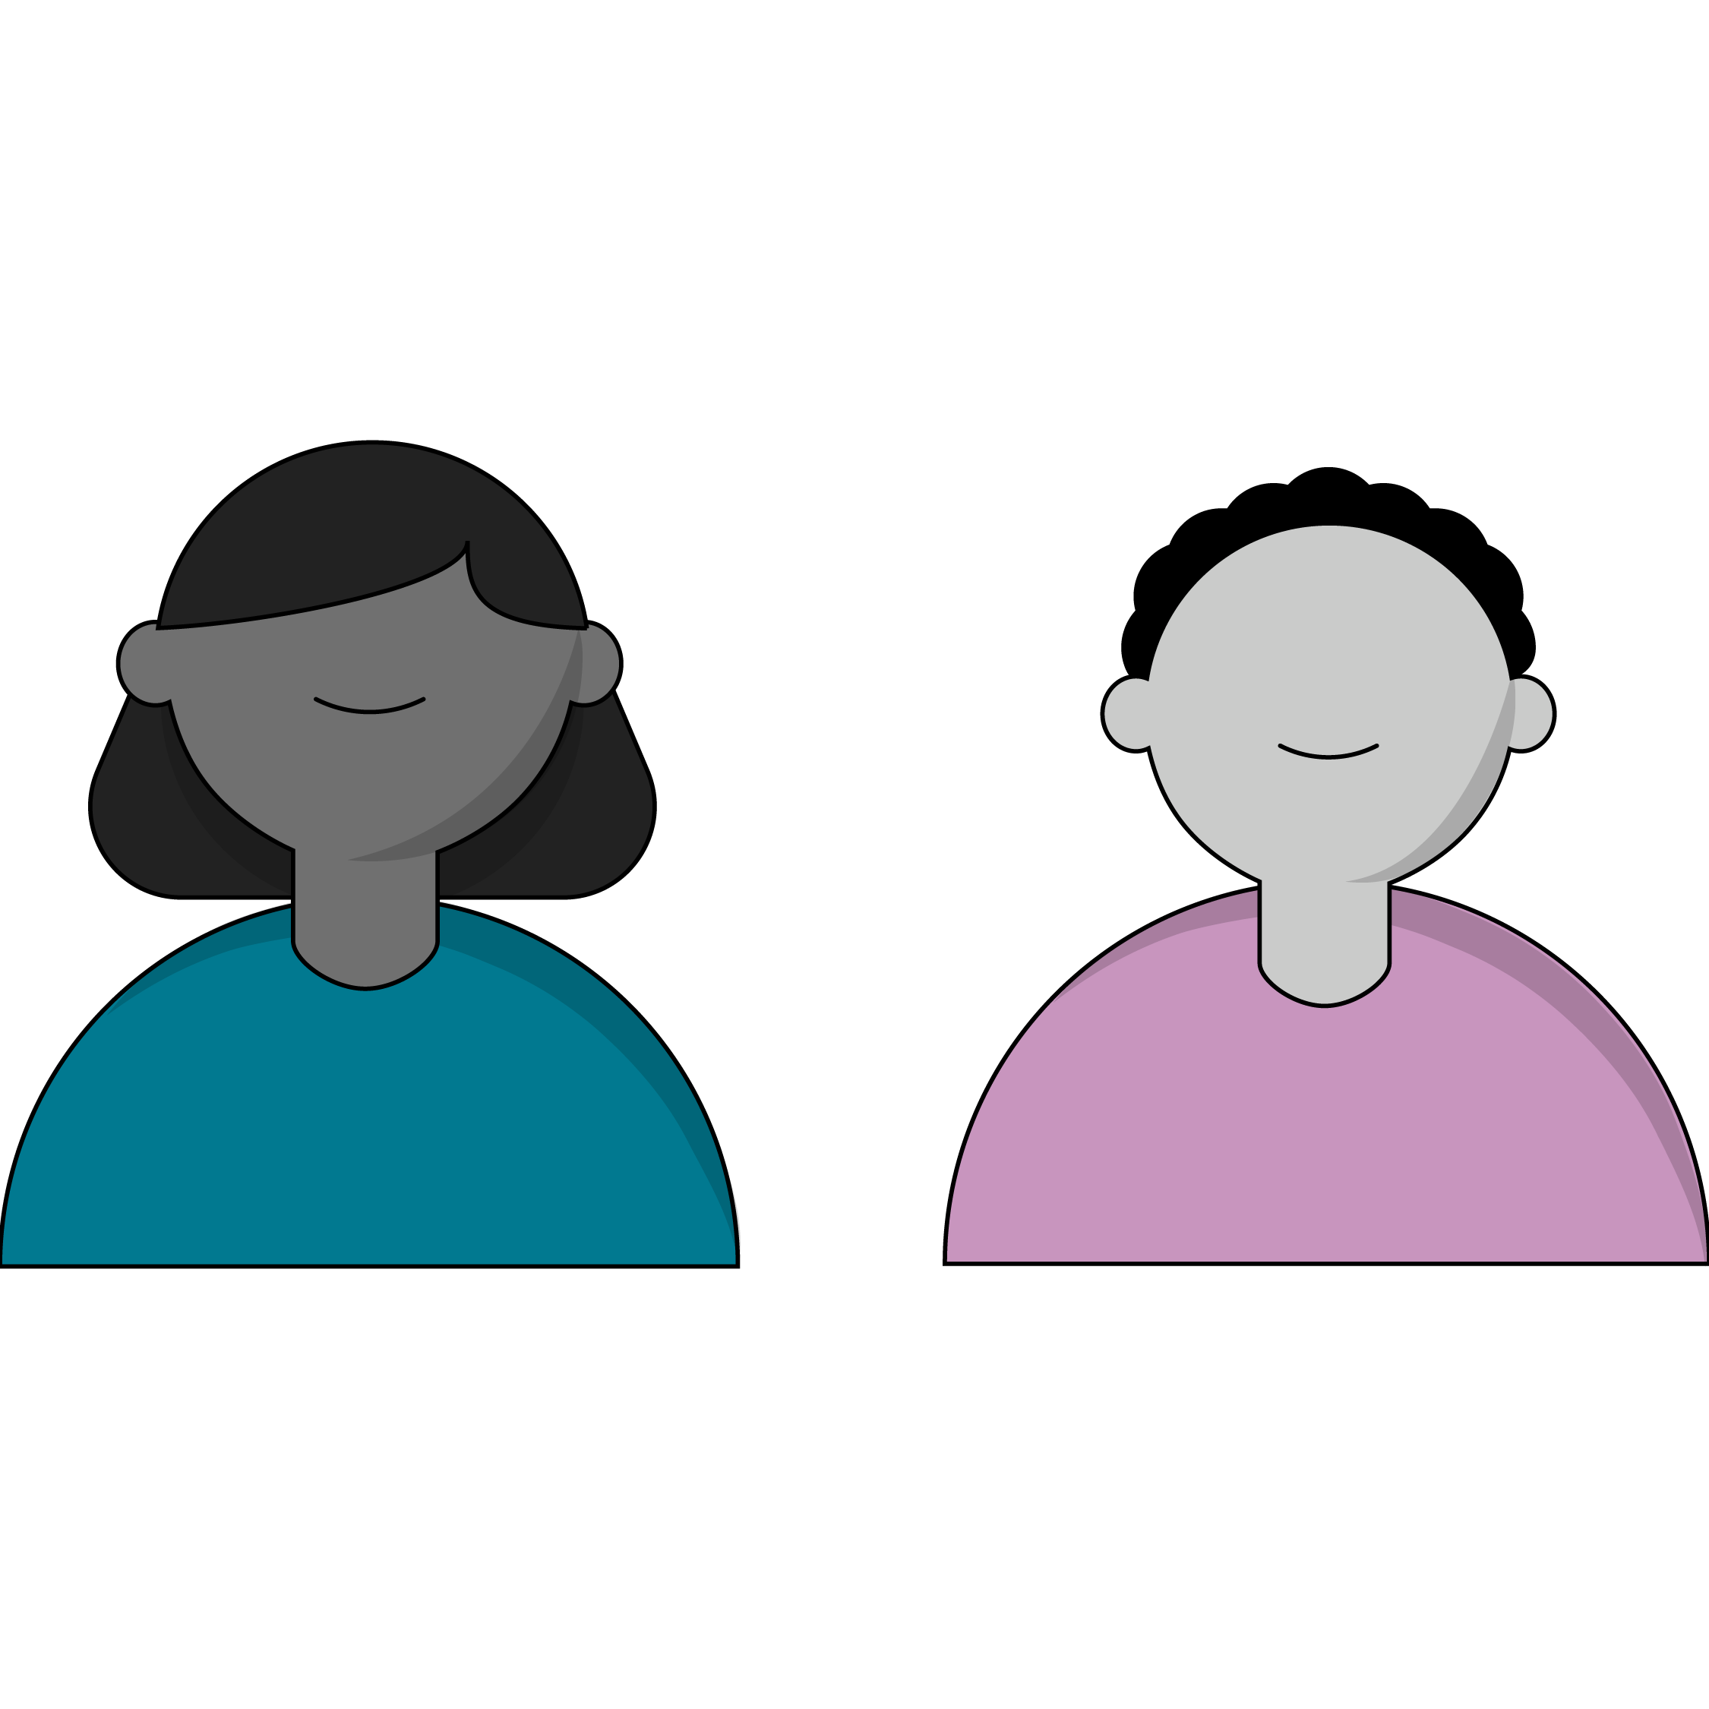
CSS Grid: A Cousin of Flexbox
Built with the modern web in mind.
Natively responsive.
Parent container → child Grid item relationship.
Much like flexbox, a parent (or “container”) element will define the layout for its children.
Notes:
TEACHING TIPS:
This is a good opportunity to bring up (again) the importance of container elements in HTML. Even if we can’t see them, they are vital for layouts and building in specific cascading styles. You can translate “natively responsive” into more accessible languages, or ask students what they think it means (“The Grid squares scale in size with browser size.”).

Slide 18
Using CSS Grid
Front-End Web Development

Slide 19
Grid Tracks
(That’s what the rows and columns are called.)

Slide 20
Grid Tracks
(That’s what the rows and columns are called.)

Slide 21
Use display:grid on the Container Element
.container {
display: grid;
}
Unlike display:flex, Grid doesn’t give us much by default. We’ll have to define the template for our grid according to the rows and columns we want.
Notes:
TALKING POINTS:
This should remind you of… flexbox!

Slide 22

Think! What Kind of Layout Do You Want?
2 rows, 3 columns?
20 rows, 1 column?
9001 rows, 42 columns?
Notes:
TALKING POINTS:
“Measure twice, code once” when it comes to layouts and overarching schemes for code. Details are easy to change, but deciding on the overall structure will tie you to specific decisions that will be hard to undo without changing tons of code in many places.

Slide 23
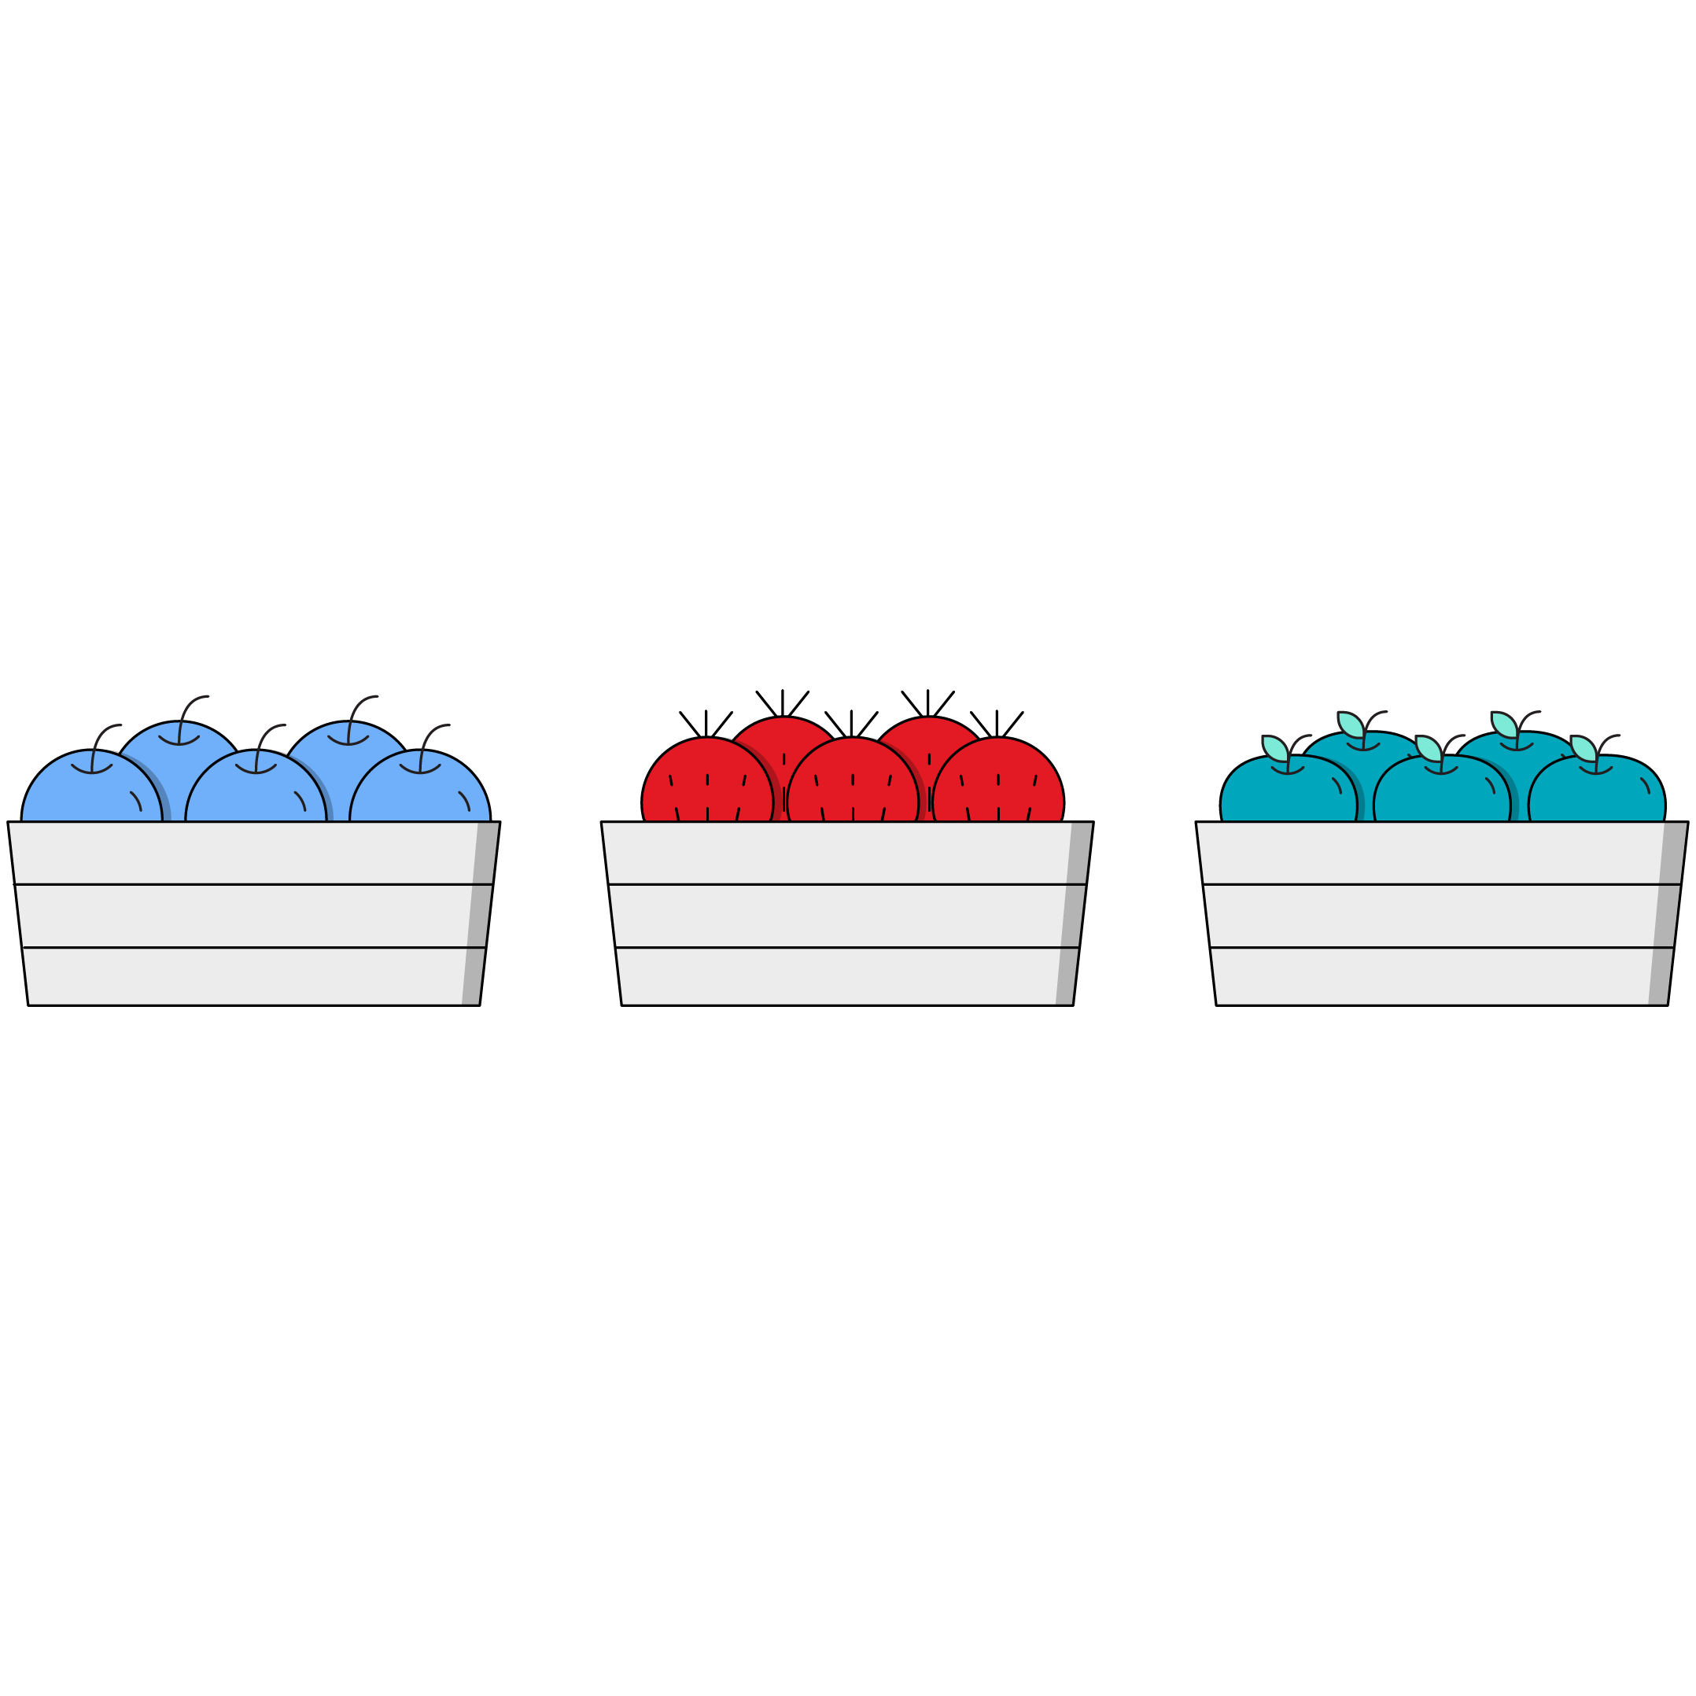
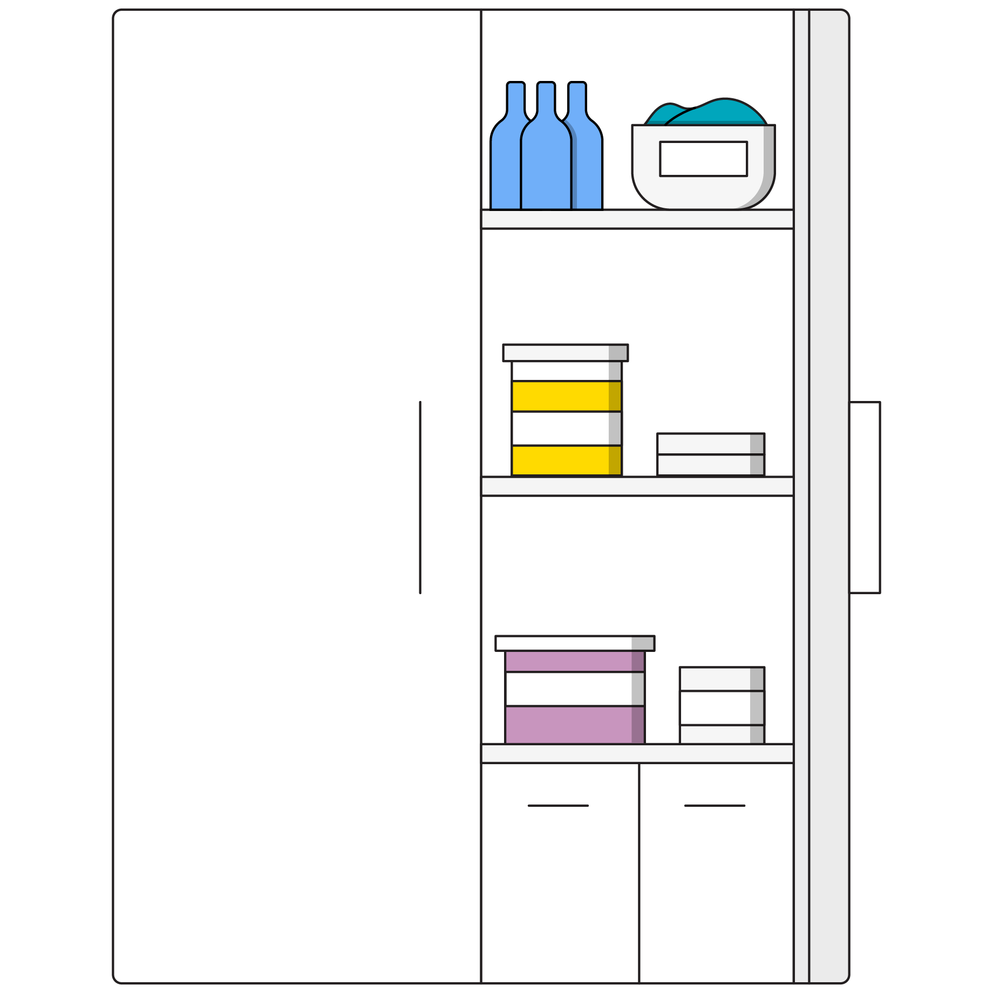
Define Your Rows and Columns
Rows
Columns
Use the CSS property
grid-template-rows.
Use the CSS property
grid-template-columns.

Slide 24
Basics in <html>
Let’s create a set of <div>’s inside of <section> tags.
<section class="container">
<div class="item">1</div>
<div class="item">2</div>
<div class="item">3</div>
<div class="item">4</div>
</section>

Slide 25
Basics in CSS
You’ll need to use grid-template-columns and grid-template-rows on the parent to create a simple grid.
/* 2 column, 1 row grid */
.container {
display: grid;
grid-template-columns: 100px 100px;
grid-template-rows: 100px;
}

Slide 26
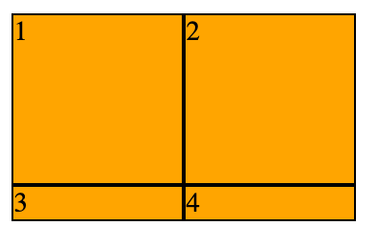
All Together Now!
/* 2 column, 1 row grid */
.container {
display: grid;
grid-template-columns: 100px 100px;
grid-template-rows: 100px;
}
.item {
background-color: orange;
}

Slide 27
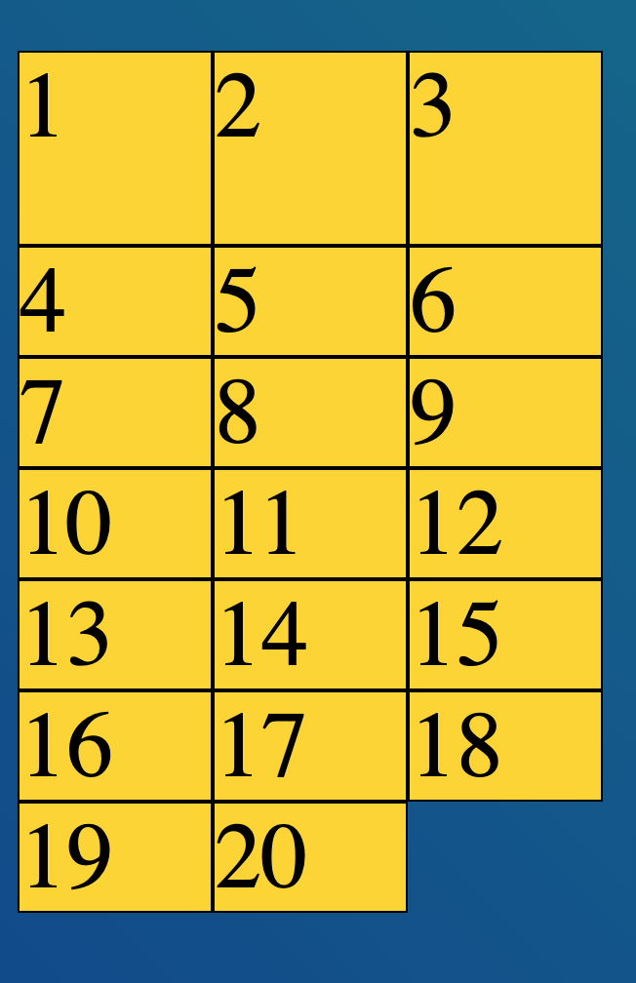
A Basic Grid Example
Check out the grid in this example as a reference for using CSS Grid properties.
Reference code:
https://drive.google.com/drive/folders/1MV5eLNCLhhXlCPYf02AJGkpxiOBJAF5N?usp=sharing
Notes:
TEACHING TIPS:
In this CodePen example, a question is raised: Why is the first row larger than the rest? This is the issue with defining the row height explicitly. Comment out the grid-template-rows and show that this “bug” gets fixed by letting the browser implicitly define rows. This is a good transition into the next topic.

Slide 28
Flex-To-Grid Code-Along
Let’s replicate grid functionality using flexbox rules!
Starter code:
https://codepen.io/GAmarketing/pen/yLLRQga
Solution code:
https://codepen.io/GAmarketing/pen/jOOeQLq
Notes:
TEACHING TIPS:
Lead the class through this.

Slide 29
Implicit Tracks
Front-End Web Development

Slide 30
Implicit Tracks
You can leave off grid-template-rows and CSS Grid will automatically make the rows (conceptually, this is called the “implicit grid”).
If we don’t know how many rows our content will take, can we still define their height?
Turns out there’s a property called grid-auto-rows for just that purpose!
Notes:
TEACHING TIPS:
Try demonstrating “css define grid row height for implicit rows” as a search phrase for this question. At about this point, start encouraging students to research their questions and try out the specific answers that come back. The whole “teach a person to fish” concept can be brought up.

Slide 31
This Also Works
/* 2 column, ?? row grid */
.container {
display: grid;
grid-template-columns: 100px 100px;
}
.item {
background-color: orange;
}
Notes:
TALKING POINTS:
We can let the content determine the height as an alternative to explicitly defining it.

Slide 32
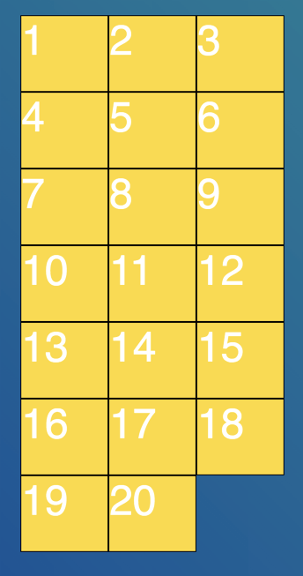
An Implicit Tracks Example
Check out the grid in this example, which uses implicit tracks for its rows.
Reference code:
https://codepen.io/GAmarketing/pen/RwwoPgR
Notes:
TALKING POINTS:
This is an example and is meant only to convey implicit tracks.

Slide 33
When You Just Need Some Space: gap
Front-End Web Development

Slide 34
Gap (grid-gap)
gap is the margin/padding of CSS Grid. If you want space between your grid items, you apply gap to the container. So easy!
.container {
display: grid;
grid-template-columns: 100px 100px;
gap: 20px;
}
.item {
background-color: orange;
}

Slide 35
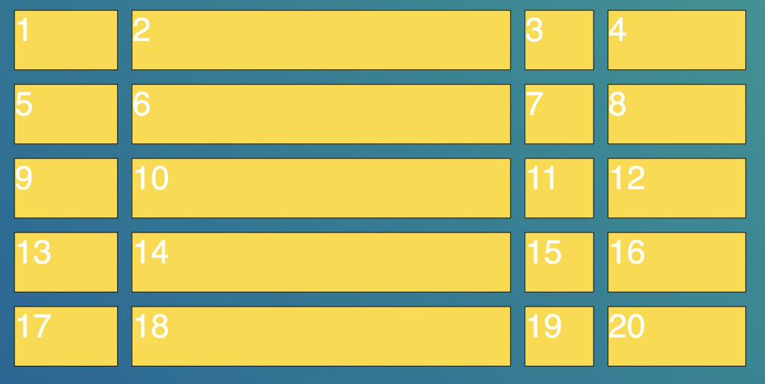
gap (Cont.)
When gap is given one value, it applies an equal amount of space between rows and columns.

Slide 36
Two-Value gap
.grid01 {
display: grid;
grid-template-columns: 100px 100px;
gap: 25px 10px;
}

Slide 37
gap (Cont.)
Keep in mind: gap can take two values, which set column and row padding (respectively).
.container {
display: grid;
grid-template-columns: 100px 100px;
gap: 20px 80px;
}
.item {
background-color: orange;
}

Slide 38
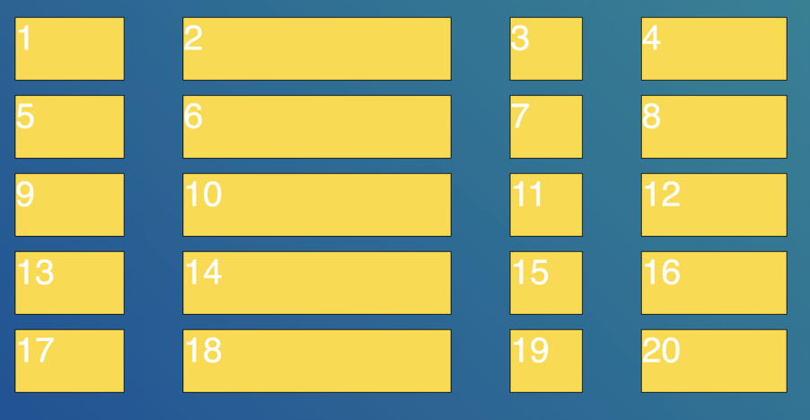
gap (Cont.)
Note the difference when gap is given two values: Different amounts of space between rows and between columns.
Notes:
TALKING POINTS:
This should remind you of the box model properties: One value for margin is all sides, two values is vertical/horizontal, and four values sets TRBL directions. Identifying common patterns is vital to developing a more intuitive understanding of the bigger picture rather than memorizing every detail independently.

Slide 39
A gap Example
Use this code as a reference for incorporating grid-gap properties.
Reference code:
https://drive.google.com/drive/folders/17FxK3LTFr24c2HIwe8xDHWxRRATVv5Jk?usp=sharing

Slide 40
Fractional Units With CSS Grid
Front-End Web Development

Slide 41
Fractional Units
The fractional unit (fr) is a newer unit to be used with CSS Grid (similar to percentages). It stands for fractions of a grid container, and it intelligently takes gap into account.
.container {
display: grid;
grid-template-columns: 1fr 1fr 1fr 1fr;
gap: 20px;
}

Slide 42

Can I Use Different Measurement Values Together?
We can feel free to mix fixed-width and variable-width units such as pixels, fr, and percentages.
They can be used together. When used together with fixed-width units, fr is saying: ‘Use the remainder of the space left over after the fixed-width units.’

Slide 43
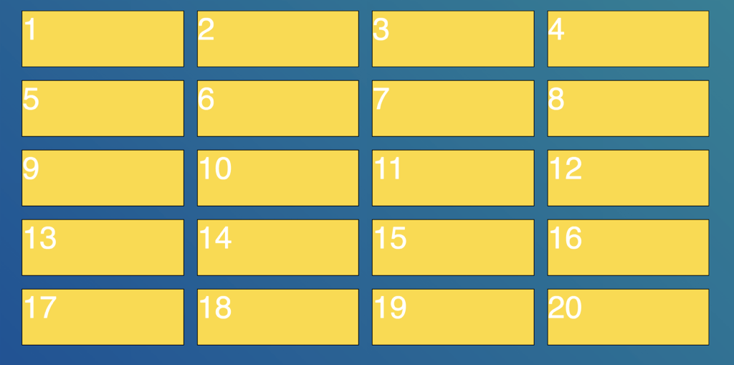
A fr Unit Example
The following code demonstrates how to use fractional units to generate this grid.
Reference code:
https://drive.google.com/drive/folders/1z0mMVm6FZjw5GcDDwnLWuzL9PW9pPMDn?usp=sharing

Slide 44
Make a Grid With Images
20-30 minutes
Build a grid of the images provided in the starter code. The images are BIG! How can you solve for that?
Starter code:
https://codepen.io/GAmarketing/pen/zYYMZqL
Solution code:
https://codepen.io/GAmarketing/pen/WNNYppj
Notes:
TEACHING TIPS:
This is another blended code-along/self-guided activity. I usually let the students run with it for 20–30 minutes, then come back and code-along to finish the job.
Midway through self-guided work, it’s good to bring up the idea of responsive images. Do the whole “height: auto; + max-width: 100%” trick so they can see the image respond to the grid changing sizes. Move the page width around so they can see it. Part of what you want them to see is how LITTLE code is required to get this done.
Additional image gallery starter/solution code:
Starter: https://codepen.io/jkeohan/pen/wbMNbP
Solution: https://codepen.io/jkeohan/pen/yWNxmE?editors=0100

Slide 45
Layout Challenge
20-30 minutes
Let’s rebuild our layout challenges using CSS Grid.
Starter code:
https://drive.google.com/drive/folders/1Of4DhVVXy09EJVScp6_DDQy-ByuCwuQ3?usp=sharing
Solution code:
https://drive.google.com/drive/folders/1vs3LrTOmOwH5Wix8ZXcRkJstCrD5UR_S?usp=sharing
Notes:
TEACHING TIPS:
This is another blended code-along/self-guided activity. I usually let the students run with it for 20–30 minutes, then come back and code-along to finish the job.
Midway through self-guided work, it’s good to bring up the idea of responsive images. Do the whole “height: auto; + max-width: 100%” trick so they can see the image respond to the grid changing sizes. Move the page width around so they can see it. Part of what you want them to see is how LITTLE code is required to get this done.
Additional image gallery starter/solution code:
Starter: https://codepen.io/jkeohan/pen/wbMNbP
Solution: https://codepen.io/jkeohan/pen/yWNxmE?editors=0100

Slide 46
Mixing Layout Methods
Front-End Web Development

Slide 47
Combining Layout Tools
You can use CSS Grid with flexbox and even floats. They all have a role to play and a purpose in your toolkit.
Float an image when you want text to wrap around it.
Flexbox works great for website navigation and big horizontal sections.
Grid is a great tool for large, repetitive display patterns.
Experiment! There isn’t just a single way to build layouts; experience will help you select the right tool.
Notes:
TEACHING TIPS:
If students haven’t heard it 100 times already, this is another chance to bring home the “not just one right way” theme that permeates web development and beginner classes especially.

Slide 48
Grid + Flexbox
See how these tools work together in this CodePen.
Reference code:
https://codepen.io/GAmarketing/pen/eYYQWeO
Notes:
TEACHING TIPS:
Extend this example as a code-along as you explain how these layout methods work together.

Slide 49
Key Takeaways
For Next Time
Grids Use Two Dimensions
HTML + CSS Layouts Lab
Define rows and columns in either pixels or responsive units.
Implicit tracks can be used to expand patterns indefinitely.
We’ve learned a lot so far. Time to put it to good use!

Slide 50
Git
Front-End Web Development

Slide 51
What Is Git?
Git is a database for all of your code (version control).
It's a particular kind of version control called distributed version control. This means multiple people can make edits to the same codebase at once.
This can be a hard concept to wrap your head around — see the diagram on the next slide.

Slide 52
Server Computer
Version Database
version 3
version 2
version 1
Computer A
Computer B
file
file
Version Database
Version Database
version 3
version 3
version 2
version 2
version 1
version 1
Image Source: git-scm.com

Slide 53
Git Commands
Command | Explanation
init | Creates a repository in the current directory (folder).
add | Stages the specified files to prepare them for a commit.
commit | Saves the current state of the repository.
push | Sends local repository contents to a remote repository.
clone | Downloads a remote repository onto your local machine.
pull | Syncs one version of a repository with another.
Notes:
TEACHING TIPS:
There’s a lot about GitHub that will be confusing at first. Demonstrating each of these steps and writing them on the board in sequence as a “cheat sheet” should be very helpful.

Slide 54
Let’s Set Up Our User
git config --global user.name “Your Name”
git config --global user.email “you@yourmail.com”
Notes:
TEACHING TIPS:
There’s a lot about GitHub that will be confusing at first. Demonstrating each of these steps and writing them on the board in sequence as a “cheat sheet” should be very helpful.

Slide 55
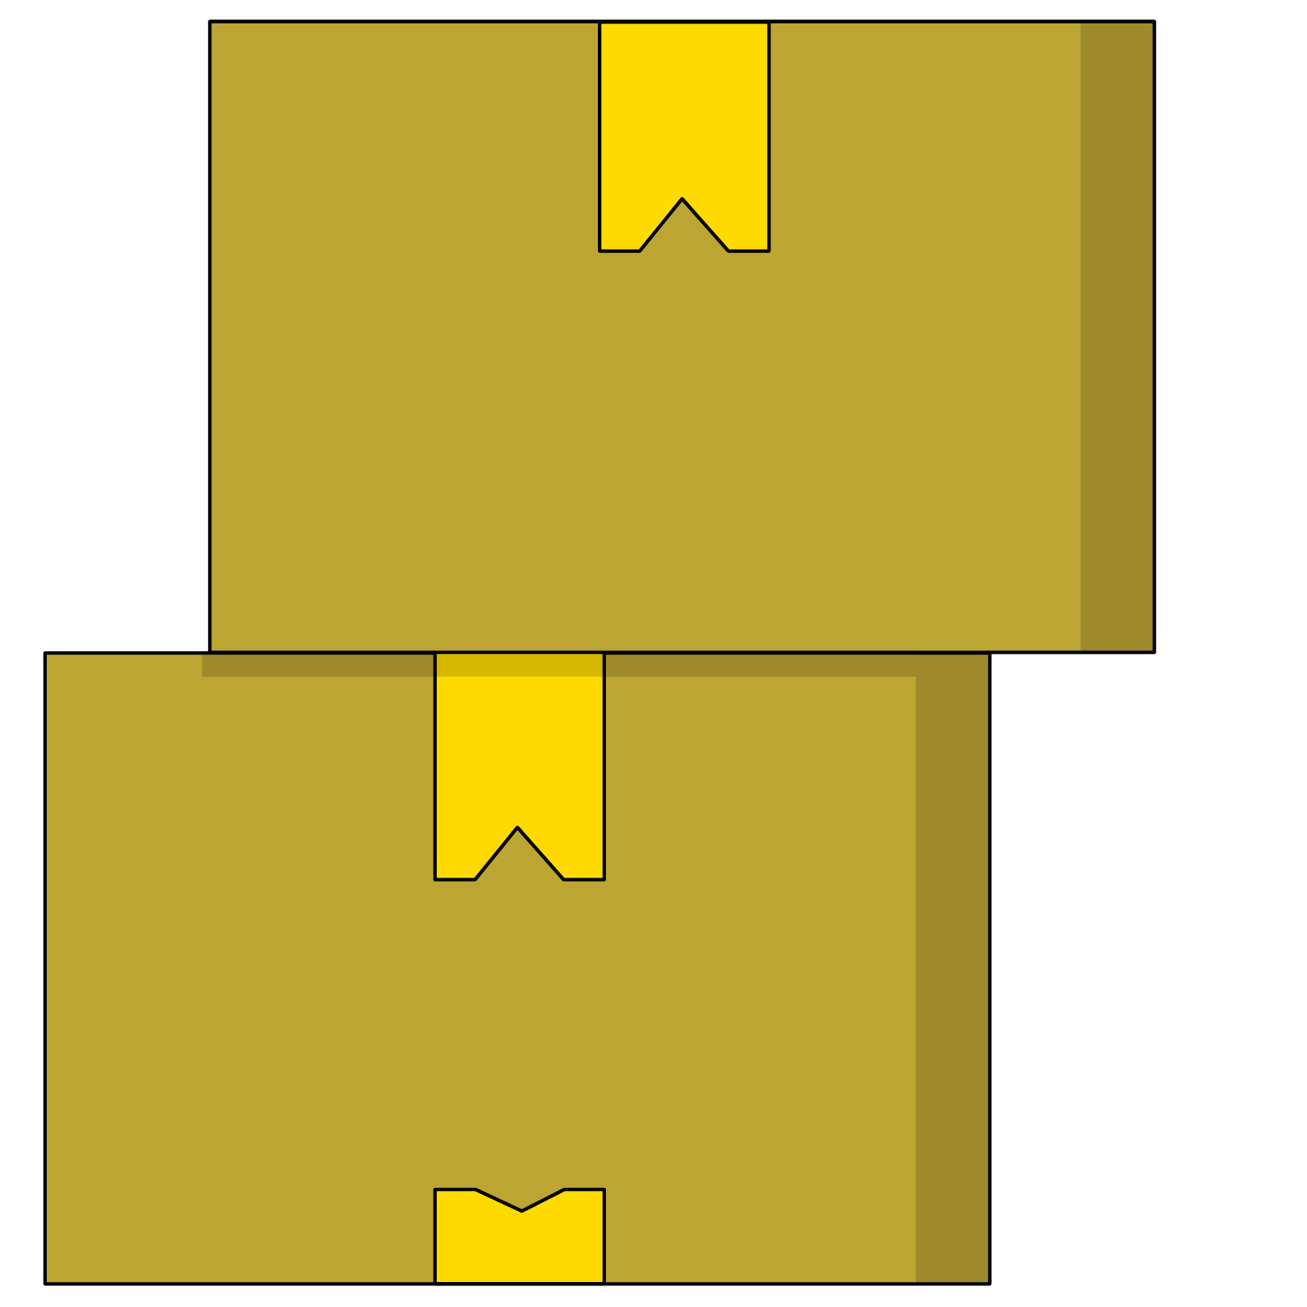
Storing a Project on GitHub
Choose any of the previous assignments or projects and store them in a repository using the command line, then push that repository to a repository on github.com.
Use your text editor to create the folder structure and copy files into a new folder.

